Slide 1


INTRODUCTION TO MACHINE LEARNING
Ecommerce Customer Churn Analysis and Prediction
Group - 5
MEGHAVI SINGHANIYA
ANUBHAV NEHRU
ANUKUL KUMAR SINGH
HAYOUNG KIM
JAHNAVI ANGATI

Slide 2
Table of Contents
Overview
Intro to Data
Modelling
Conclusion
Notes:
This is the overall reason why we choose this topic.

Slide 3

What are we aiming to do?
Utilize Customer attributes such as Tenure, recency and cashback liability to predict Customer Churn for an eCommerce platform

Slide 4
What is Churn Rate Important?
Because Customer Retention matters in every business!
Attracting new customers is costly
According to Harvard Business Review and Forbes,
“Depending on which study you believe, and what industry you’re in, acquiring a new customer is anywhere from 5 to 25 times more expensive than retaining an existing one”
An Increase in customer retention will bring more profits growth to company
According to Outbound Engine (Marketing Automation company),
“Increasing customer retention by 5% can increase profits from 25% to 95% ”
Hence it is important to predict the customer’s churn and prevent it!
Notes:
Anukul

Slide 5
Methodology:
Replace missing numerical values by Median
Encode categorical variables to use them in the model
Find correlation between different metrics.
Find correlation of key metrics with churn rate
Split the data into test/train.
Run the selected model for the best parameters based on Randomized search
Find the best suited algorithm based on AUC score and accuracy-based metrics predominantly Recall.
Data Preprocessing
EDA
Model Selection
Notes:
Anukul

Slide 6
Table of Contents
Overview
Intro to Data
Modelling
Conclusion
Notes:
This is the overall reason why we choose this topic.

Slide 7
Overview of Data:
1 (Exit) – 16.84%
5630 Observations
20 Attributes
Response Variable: Churn
0 (Not Exit) – 83.16%
Predictors:
18 Attributes
Demographics | Customer | Transaction Related
Warehouse to Home | Tenure | Order Count
Gender | Hour Spend on App | Cashback Amount
Marital Status | No of Device Registered | Order Amount Hike from Last Year
City Tier | No of Address | Coupon Used
 | Satisfaction | Days Since Last Order
 | Preferred Login Device | Preferred Order Category
 | Preferred Payment Mode
 | Complain(Y/N)
11 Numerical Variables
7 Categorical Variables
Note: We have dropped the customer ID variable since it was an indexing variable
Notes:
Zoe

Slide 8
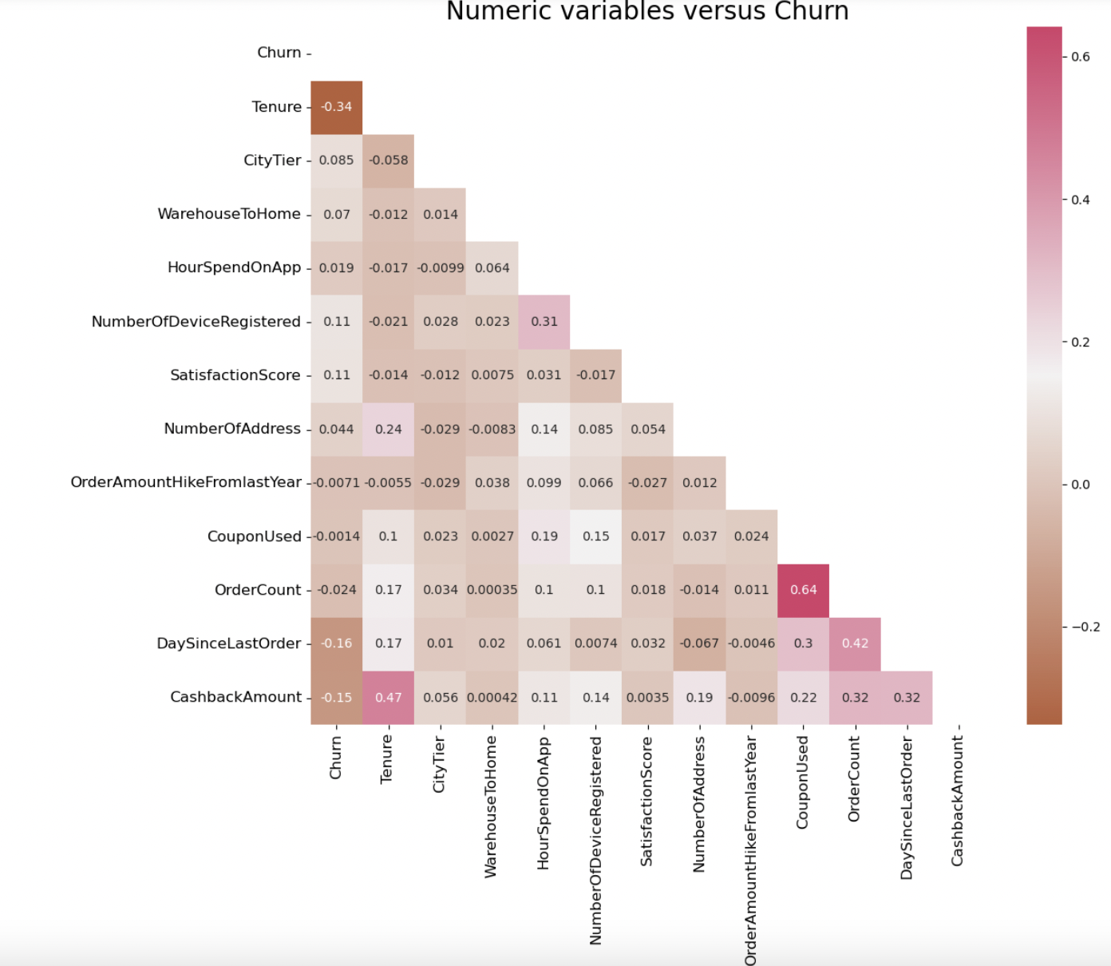
What would be the most impacting predictors?
<Numerical Variables versus Churn>
Highly Correlated Predictors with Churn
Tenure 0.34
Day Since Last Order 0.16
Cashback Amount 0.15
Other High Correlations
Order Count–Coupon Used 0.64
Tenure– Cashback Amount 0.47
Notes:
Zoe

Slide 9
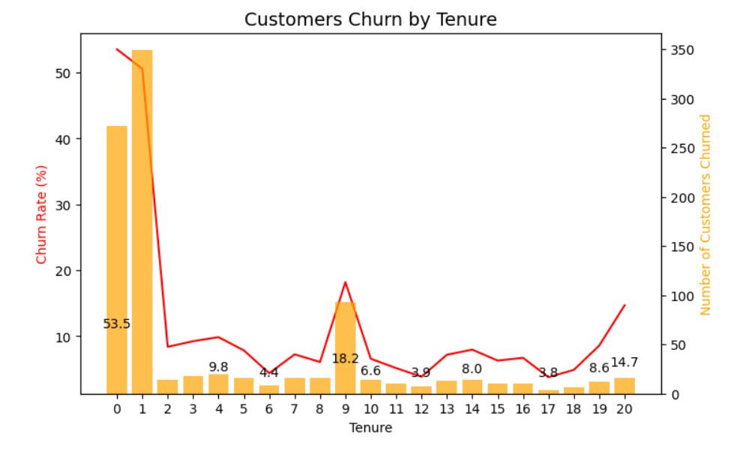
Customers churn by Tenure
Maintaining customers tenure at least for 2 years is the key.
Notes:
Zoe

Slide 10
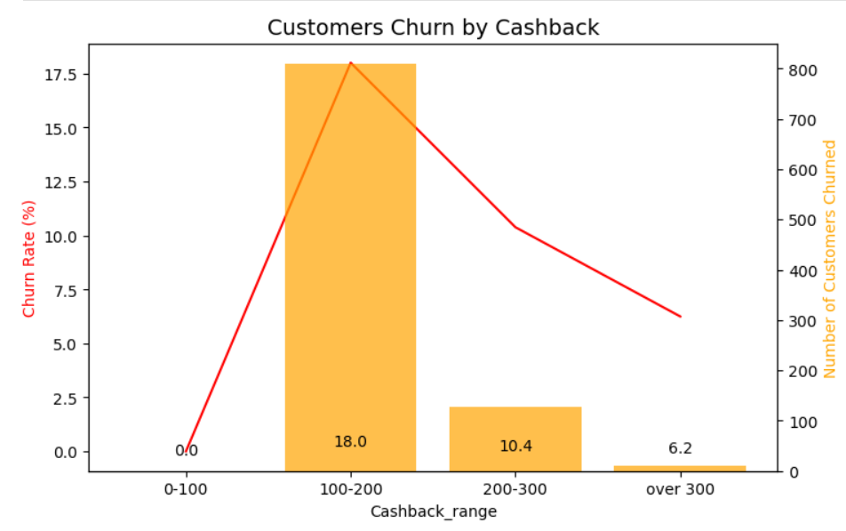
Customers churn by Cashback Amount
Higher cashback amounts are associated with lower chances of churn.
Notes:
Zoe

Slide 11
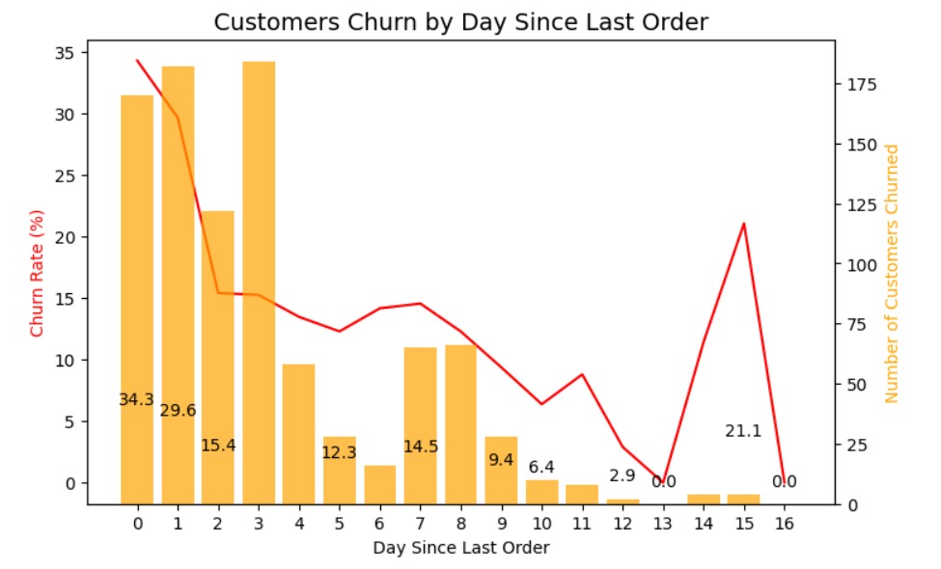
Customers churn by Day Since Last Order
For around 30% of possibility, customers are likely to churn out shortly after their purchase.
Notes:
Zoe

Slide 12
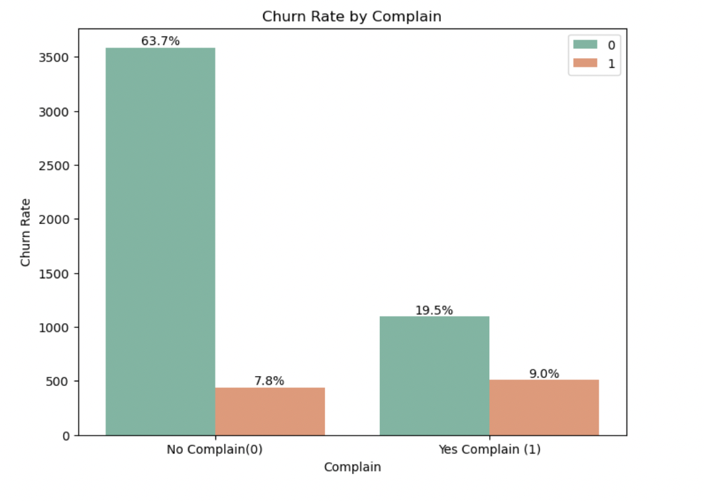
Customers churn by Complain
For Almost half of customers who complained churned out.
The company should look after not only the explained complains but also the latent ones.
Notes:
Zoe

Slide 13
Table of Contents
Overview
Intro to Data
Modelling
Conclusion
Notes:
This is the overall reason why we choose this topic.

Slide 14
Model Training : We used 5 different classification models and Decision Tree performed at Recall of 0.90 and the highest AUC score of 0.915
[X1,X2,X3,….,Xn]
Gradient Boosting
KNN Classifier
Accuracy was a skewed metric for the data given the class imbalance – So we have looked at Recall and AUC score to determine the best model.
Random Forest Classifier
Decision Tree Classifier
Logistic Regression
[Y]
In our case Decision Tree performed the best without overfitting the data, with metrics as below In Sample Accuracy : 0.97 Out of Sample Accuracy : 0.94 Precision : 0.91 Recall : 0.90
Notes:
This is the overall reason why we choose this topic. Anubhav

Slide 15
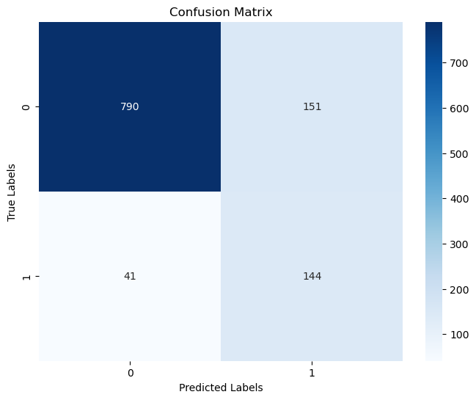
Logistic Regression:
Accuracy | Precision | Recall | AUC Score
0.81 | 0.49 | 0.78 | 0.85
As the p-values for Coupon Used and Preferred Payment Mode is not significant, i.e., not less that 0.05, we will drop the columns from the data to train the model
We use the optimal threshold of 0.217 because that gives us better recall.

Slide 16
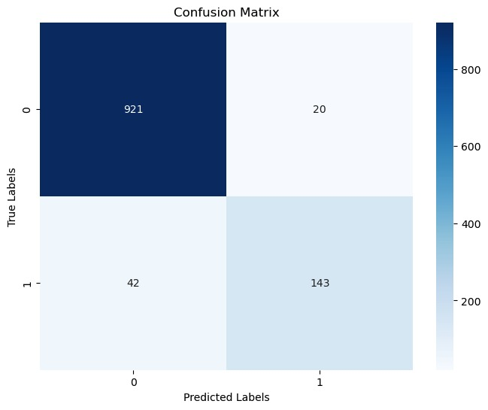
Decision Tree Classifier:
Accuracy | Precision | Recall | AUC Score
0.94 | 0.48 | 0.77 | 0.94
Parameters | Values
Max Depth | 10
Min Samples Split | 2
Min Samples Leaf | 1
Split Criterion | Gini Index
Notes:
min_samples_split specifies the minimum number of samples required to split an internal node, while min_samples_leaf specifies the minimum number of samples required to be at a leaf node.

Slide 17
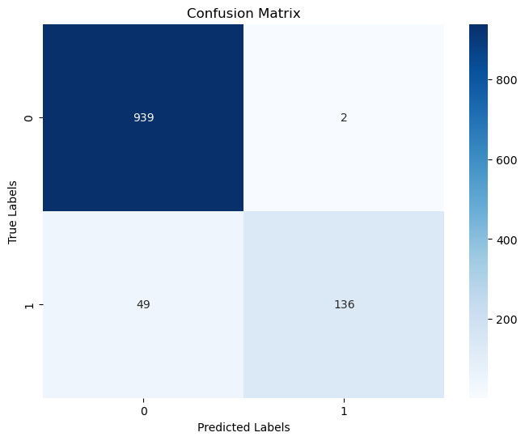
Random Forest Model:
Accuracy | Precision | Recall | AUC Score
0.95 | 0.99 | 0.72 | 0.94
Parameters | Values
N_Estimators | 1757
Max Depth | 2
Min Samples Split | 1
Min Samples Leaf | 50
Split Criterion | Entropy

Slide 18

Gradient Boosting Model:
Accuracy | Precision | Recall | AUC Score
0.91 | 0.80 | 0.63 | 0.81
Parameters | Values
N_estimators | 3000
Max_Depth | 10
Learning_rate | 0.01

Slide 19

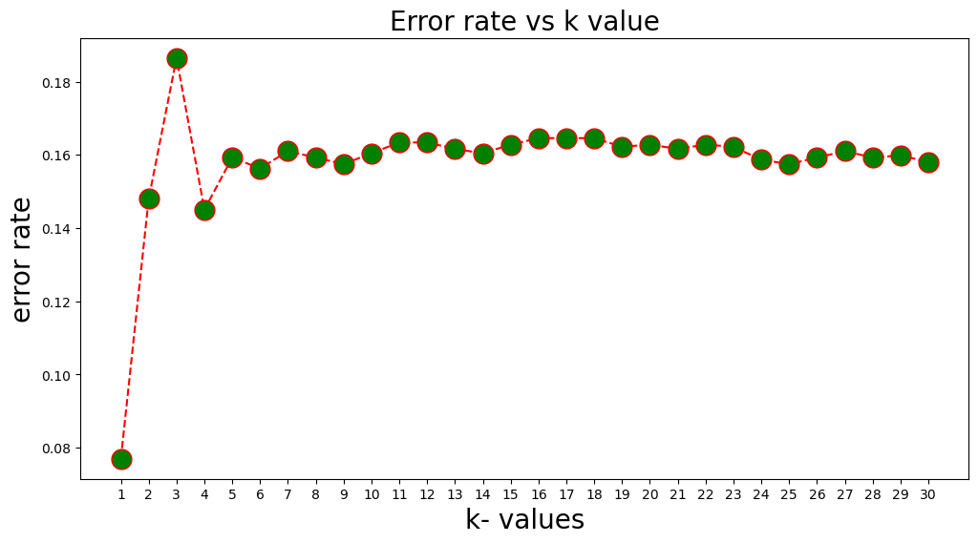
KNN Classifier:
Accuracy | Precision | Recall | AUC Score
0.93 | 0.90 | 0.68 | 0.83
K=4 gives us the best results since below that the model tends to overfit

Slide 20
Model Comparison
Model | ISS Accuracy | OOS Accuracy | Precision | Recall | Parameters
Logistic Regression | 0.81 | 0.83 | 0.49 | 0.78 | Optimal Threshold = 0.217
Decision Tree Classifier | 0.97 | 0.94 | 0.91 | 0.77 | Max depth: 10 Min Samples Split: 2 Min Samples Leaf: 1 Criterion: Gini Index
Random Forest Classifier | 0.98 | 0.95 | 0.99 | 0.72 | N_estimators: 1757 Max depth: 50 Min samples split: 2 Min Samples Leaf: 1 Criterion: Entropy
Gradient Boosting | 0.93 | 0.95 | 0.80 | 0.63 | N_estimators: 3000 Max depth: 10 Learning Rate: 0.01
KNN Classifier | 0.96 | 0.83 | 0.90 | 0.68 | K = 4
Notes:
Recall is more important because it's preferable to have a model that does not miss any churns but sometimes classify a non-churns as churns, than a model that does not classify non-churns as churns but misses a lot of churns

Slide 21
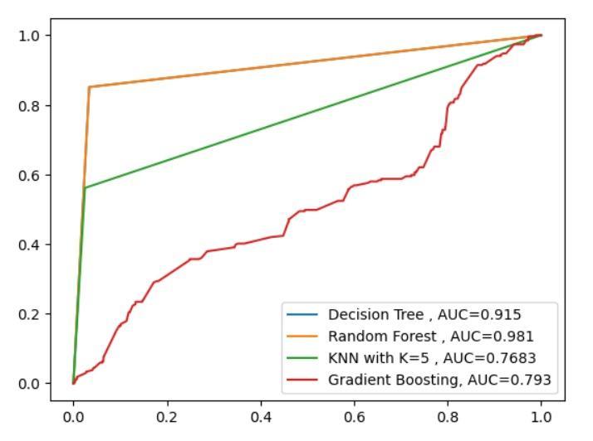
ROC Curve:
Notes:
Random forest has a higher AUC score due to overfitting. Thus, it has been rejected.

Slide 22
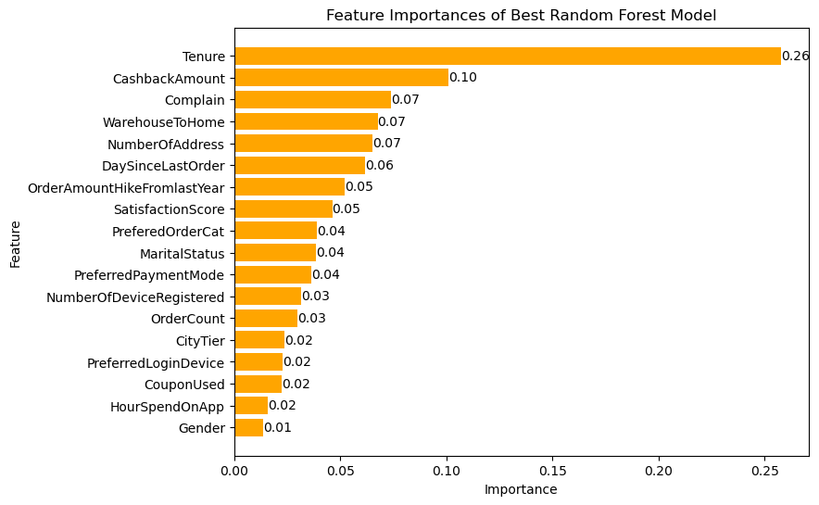
Finding the Variable Importance:
Notes:
Meghavi

Slide 23
Table of Contents
Overview
Intro to Data
Modelling
Conclusion
Notes:
This is the overall reason why we choose this topic.

Slide 24



Tenure, Warehouse to Home distance, Complain and cashback amount are the key variables that impact customer churn
CONCLUSION
Decision Tree was the best way to predict churn rate
Recommendation: Focus on Customer Experience and Lower Complain Rates
Notes:
Links: When we talk about growing revenues, we typically focus on customer acquisition—your sales, marketing, and customer onboarding efforts. However, there is another key component of revenue growth: customer retention
https://www.pexels.com/photo/photo-of-people-holding-each-other-s-hands-3184434/

Slide 25
THANK YOU

